Slide 1
Outlines
Software Development Life Cycle (SDLC)
Static and Dynamic Design
Architectural Pattern
Layered Architecture
GitHub

Slide 2
Software Development Life Cycle
SDLC
Static and Dynamic design
Architectural Pattern
Layered Architecture
GitHub
Customer Software Requirements Analysis
Software Design
Software Development
System Integration
System Validation

Slide 3
Static and Dynamic design
SDLC
Static and Dynamic Design
Architectural Pattern
Layered Architecture
GitHub
Static Design
High level Design
Low level Design
High level design is related to how the system is designed. What are the components of the system, which components will communicate with which components. It is like the building façade.
Low level design is related to how the components are build what are the building blocks of each component. It is like the interior design of an apartment.

Slide 4
Static and Dynamic design
SDLC
Static and Dynamic Design
Architectural Pattern
Layered Architecture
GitHub
Dynamic design answers the question when?. When this component is going to communicate to this component. It is based on an operating system.
Dynamic design determines all the dynamic information about the system components. When these components are being called, The execution time of this components and the priority of these components.

Slide 5
Architectural Pattern
SDLC
Static and Dynamic Design
Architectural Pattern
Layered Architecture
GitHub
Layered Architecture
Event triggered
Microservice
Most widely used in Embedded

Slide 6
Layered Architecture
SDLC
Static and Dynamic Design
Architectural Pattern
Layered Architecture
GitHub
LIB
App Layer
Includes function calls to down layers (main)
Service Layer
Contain the OS or any other service (Communication manager, NVM manger)
HAL Layer
Implementation of software drivers of any peripheral outside the microcontorller ex: motor, display , ..
MCAL Layer
Implementation of software drivers of any peripheral inside the microcontorller ex: ADC, Timers , ..

Slide 7
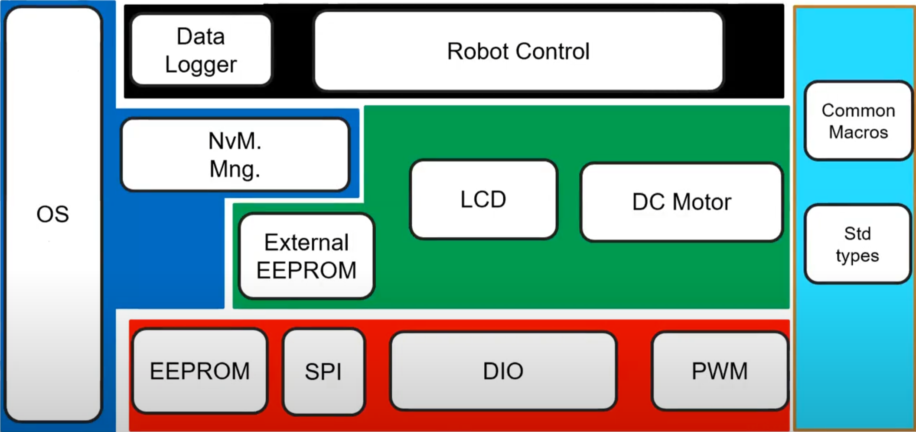
Layered Architecture
SDLC
Static and Dynamic Design
Architectural Pattern
Layered Architecture
GitHub

Slide 8
GitHub
SDLC
Static and Dynamic Design
Architectural Pattern
Layered Architecture
GitHub
GitHub, is an Internet hosting service for software development and version control using Git. It provides the distributed version control of Git plus access control, bug tracking, software feature requests, task management, continuous integration, and wikis for every project.

Slide 9
GitHub Organization
SDLC
Static and Dynamic Design
Architectural Pattern
Layered Architecture
GitHub
Organizations are shared accounts where businesses and open-source projects can collaborate across many projects at once, with sophisticated security and administrative features.
GitHub organization documentation

Slide 10
GitHub projects
SDLC
Static and Dynamic Design
Architectural Pattern
Layered Architecture
GitHub
Organization
Members
Project 1
Project 2
Project ..
A project is an adaptable spreadsheet that integrates with your issues and pull requests on GitHub to help you plan and track your work effectively. You can create and customize multiple views by filtering, sorting, grouping your issues and pull requests, adding custom fields to track metadata specific to your team, and visualize work with configurable charts.
GitHub projects documentation

Slide 11
GitHub Teams
GitHub
GitHub Organization
GitHub Projects
GitHub Teams
GitHub Issues
Organization
Members
Project 1
Project 2
Project ..
Team 1
Team ..
Team 1
Team 1
Team ..
Teams can be assigned together to work on a certain project together and have access to the same repositories. Teams' accessibility can be managed with different roles for each team member.

Slide 12
GitHub teams
SDLC
Static and Dynamic Design
Architectural Pattern
Layered Architecture
GitHub
Organization
Members
Project 1
Project 2
Project ..
Team 1
Team ..
Team 1
Team 1
Team ..
Repository
Repository
Repository
GitHub teams documentation

Slide 13
GitHub issues
SDLC
Static and Dynamic Design
Architectural Pattern
Layered Architecture
GitHub
With issue and pull request templates, you can customize and standardize the information you'd like contributors to include when they open issues and pull requests in your repository. After you create issue and pull request templates in your repository, contributors can use the templates to open issues or describe the proposed changes in their pull requests according to the repository's contributing guidelines.
GitHub issues documentation

Slide 14
GitHub Pull requests
SDLC
Static and Dynamic Design
Architectural Pattern
Layered Architecture
GitHub
Pull requests let you tell others about changes you've pushed to a branch in a repository on GitHub. Once a pull request is opened, you can discuss and review the potential changes with collaborators and add follow-up commits before your changes are merged into the base branch.
GitHub pull request

